Slide 1
Deeper muscles of the Shoulder and Arm
Overlays

Slide 2
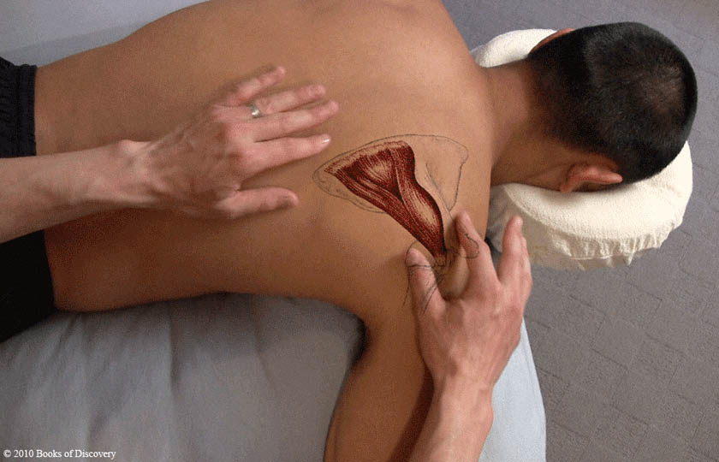
Infraspinatus 1

Slide 3
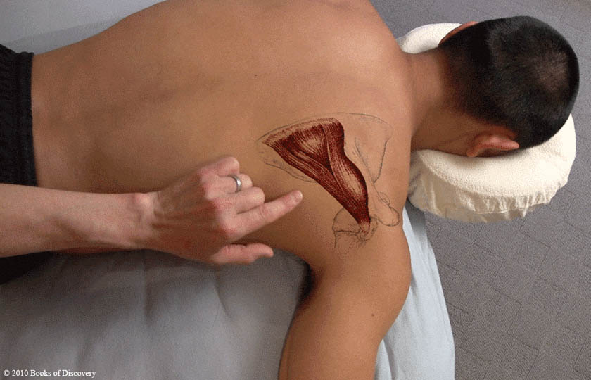
Infraspinatus 2

Slide 4
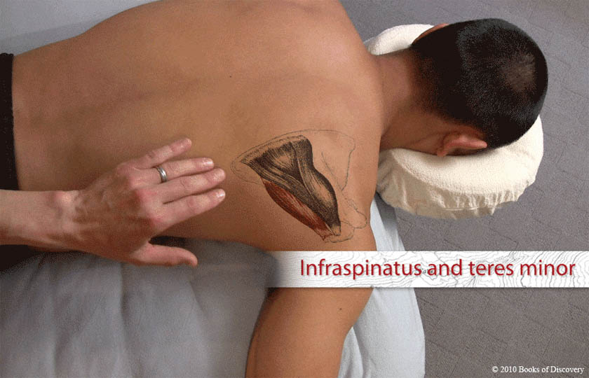
Infraspinatus & teres minor

Slide 5
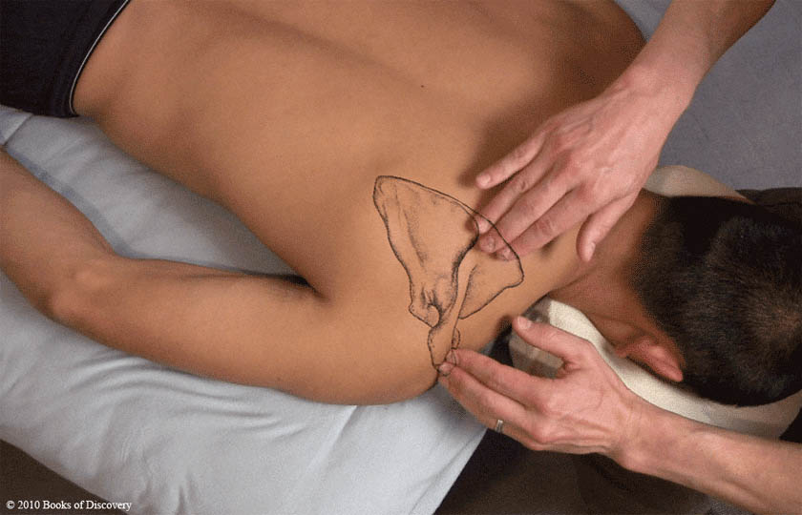
Spine of scapula

Slide 6
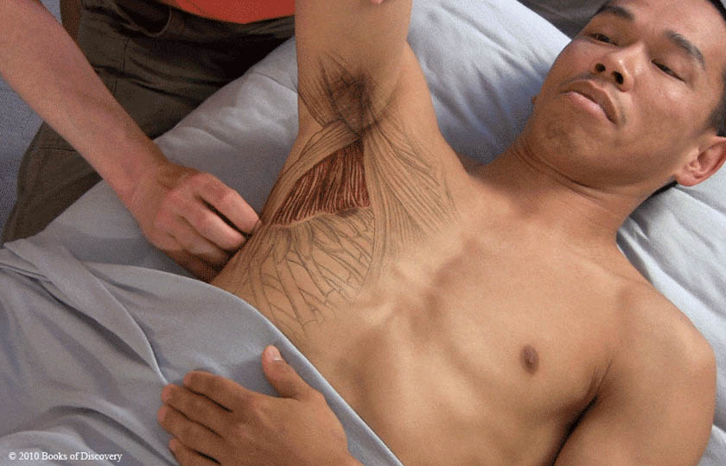
Subscapularis

Slide 7
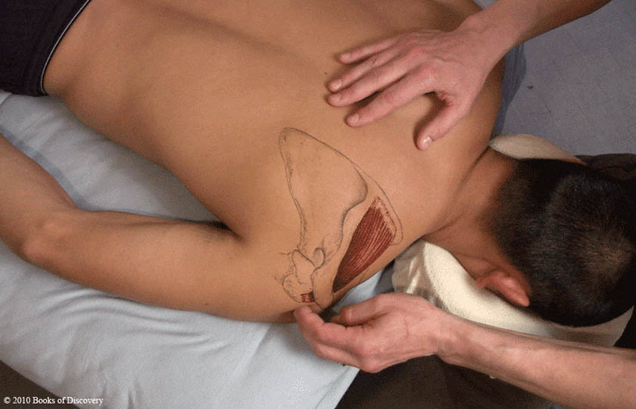
Supraspinatus & greater tubercle

Slide 8
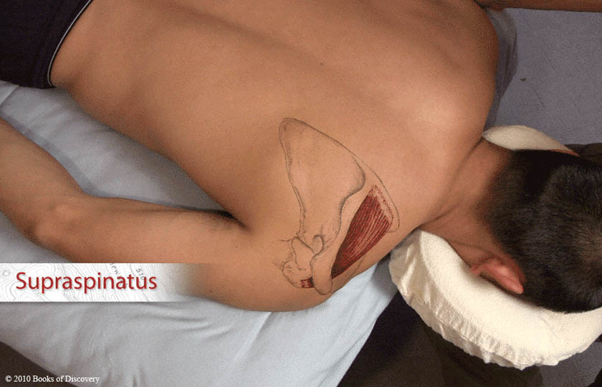
Supraspinatus

Slide 9
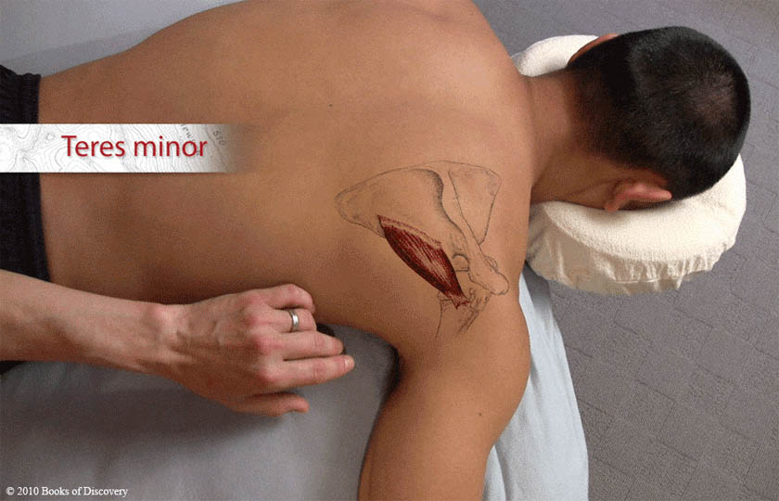
Teres minor

Slide 10
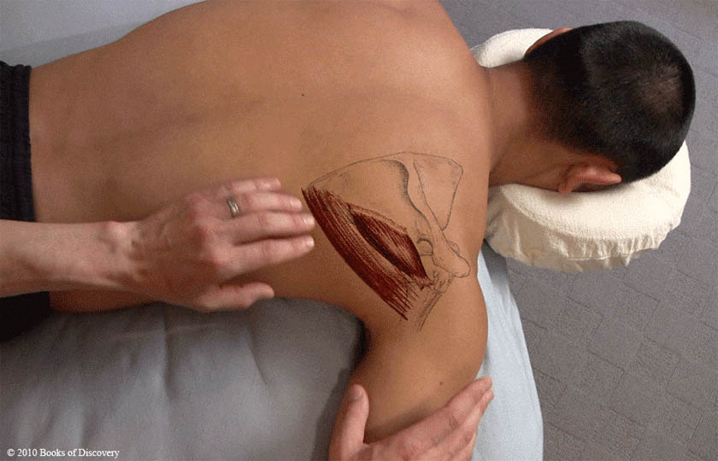
Teres major and minor

Slide 11
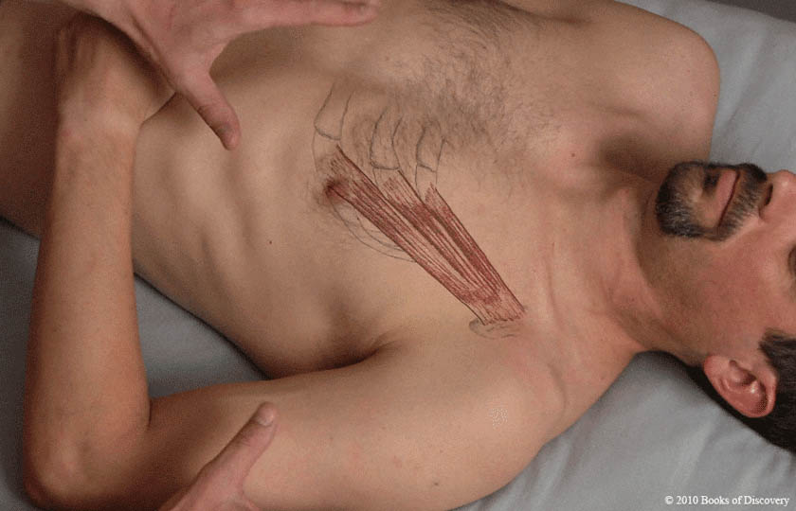
Pectoralis minor 1

Slide 12
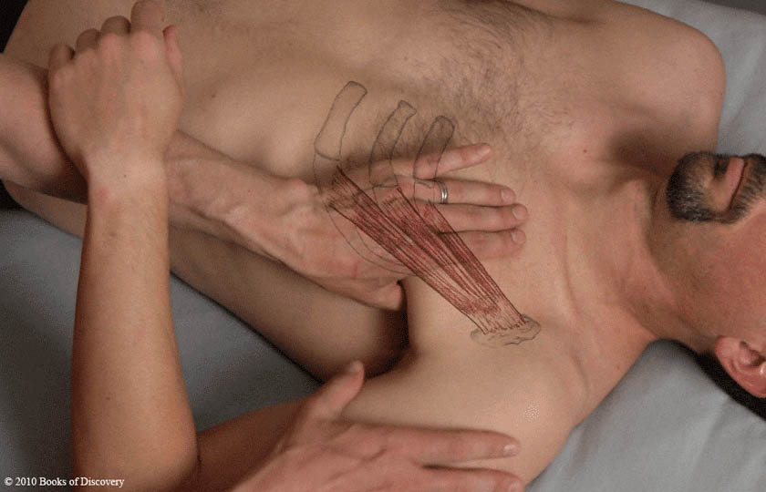
Pectoralis minor 2

Slide 13
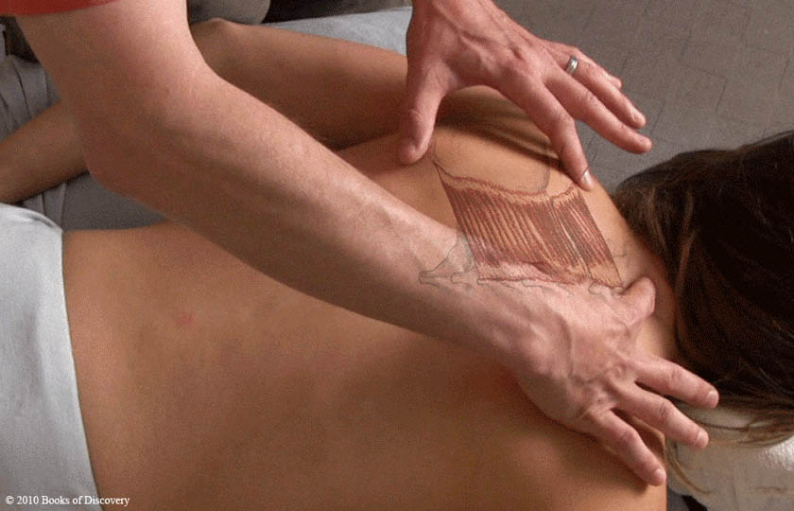
Rhomboids 1

Slide 14
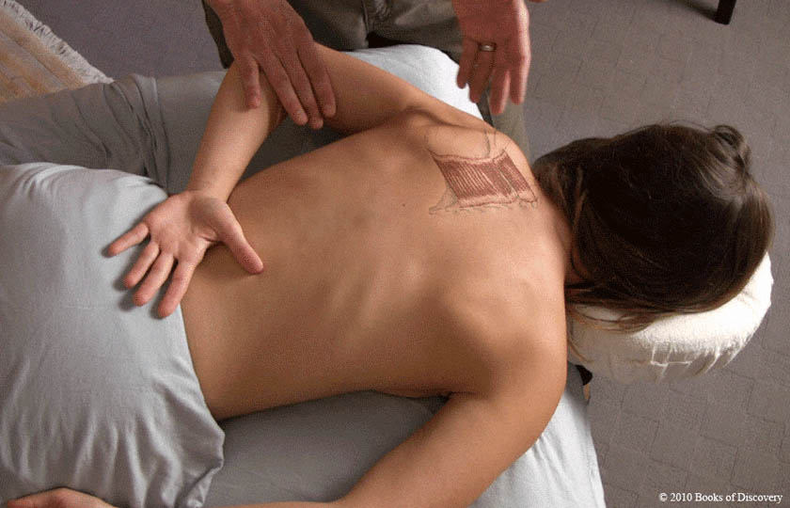
Rhomboids 2

Slide 15
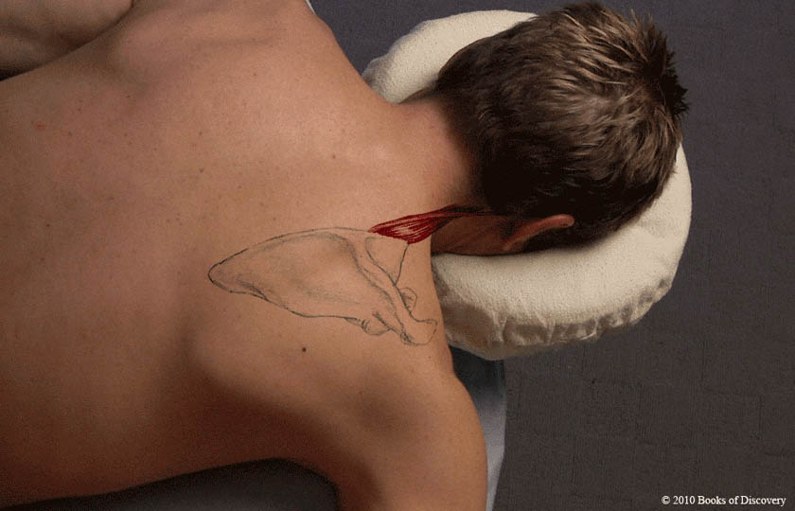
Levator scapula – prone

Slide 16
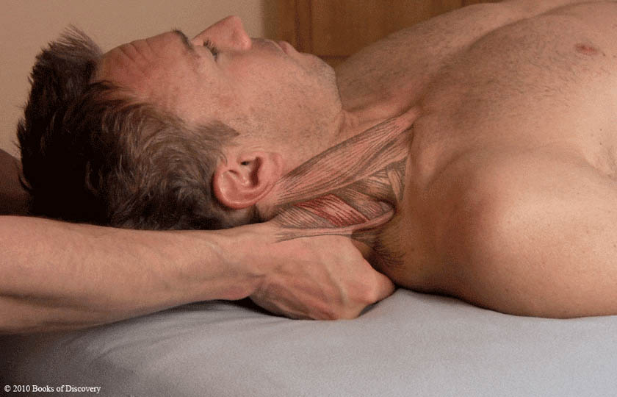
Levator scapula – supine

Slide 17
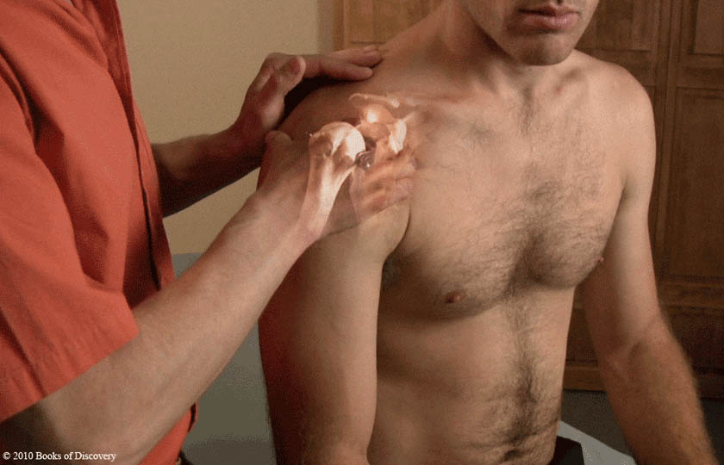
Coracoid process

Slide 18
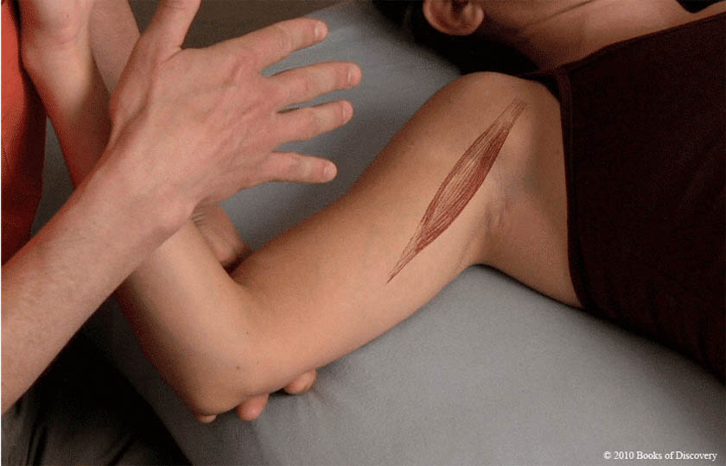
Coracobrachialis

